Slide 1
Section 3
Molality

Slide 2
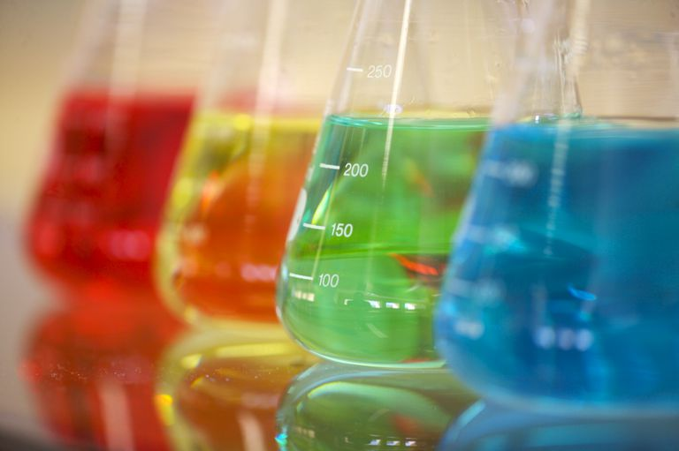
Review
Concentration is how much solute is present a certain amount of solvent or solution
So far we studied molarity

Slide 3
Molality
Ratio of the moles of solute to kilograms of solvent
Reminder: There are 1,000 g in 1 kg
mol of solute
kg of solvent
m =

Slide 4
When Given Grams
Convert grams to moles of SOLUTE from PERIODIC TABLE
Then use the formula to solve for molality

Slide 5
Example
A 8.00 g sugar cube (sucrose: C₁₂H₂₂O₁₁) is dissolved in a 275 g of water. What is the molality of the solution?
Step 1: Convert grams to mols
= 0.0234 mol
Step 2: Convert g to kg
= 0.275 kg
1 mol
8.00 g C₁₂H₂₂O₁₁ =
342 g
1 kg
275 g =
1,000 g

Slide 6
Step 3: Use the formula to solve for m
= 0.0851 m
moles of solute
Molality (m) =
Kg of solvent
0.0234 mol
m =
0.275 kg

Slide 7
Practice
Worksheet

